Slide 1

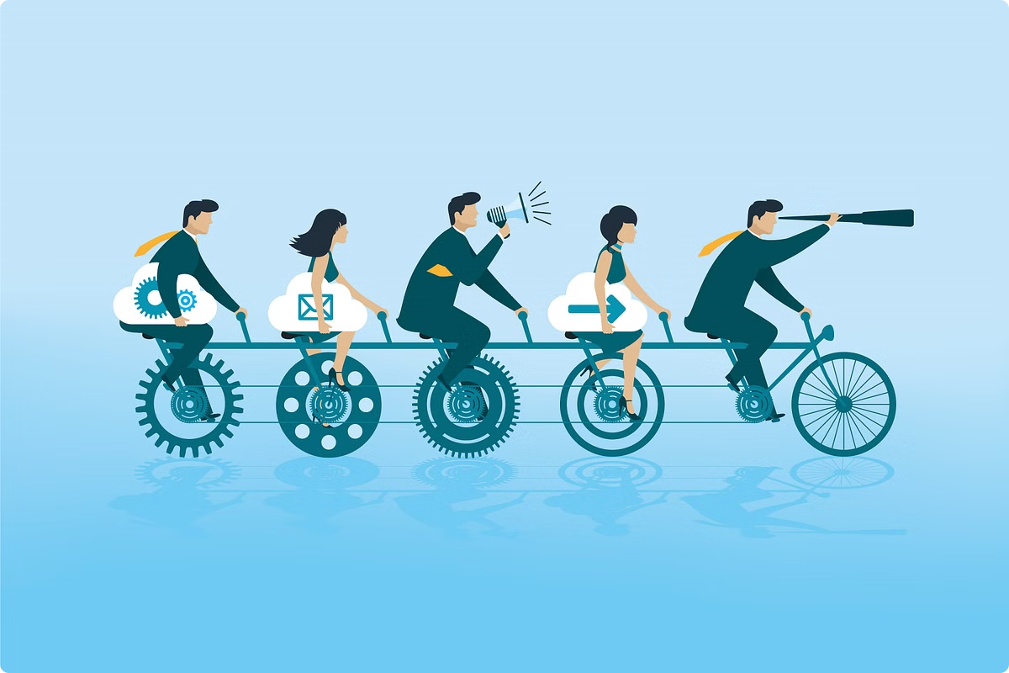
PJM 6910 Capstone Project
Weeks 3-4: Drafting Project Scope, Defining Requirements, and Sponsor Meeting
Team 4

Slide 2
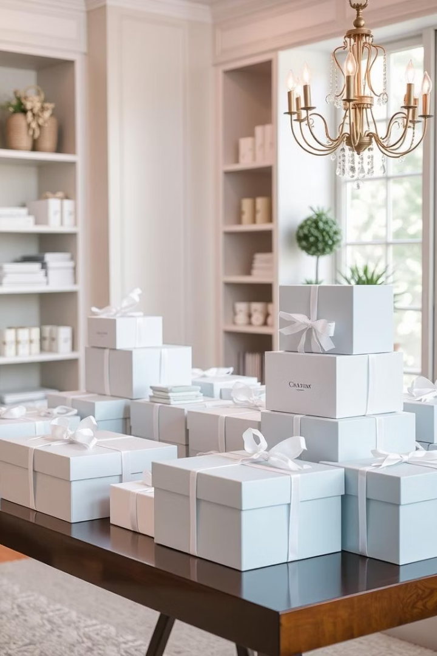

Enhancing Digital Identity for The Knots Studio
The Knots Studio, a boutique gifting venture founded in 2022 in Bangalore, India, specialises in thoughtful, customizable bulk gifting solutions for corporate clients and special occasions. Despite the founder’s extensive corporate experience, the brand currently lacks a cohesive digital presence, limiting visibility and growth potential.
This project aims to design and deliver a fully functional website that reflects the brand’s heart-driven gifting philosophy, enhancing client engagement and lead generation.
by Akrati Tripathi

Slide 3
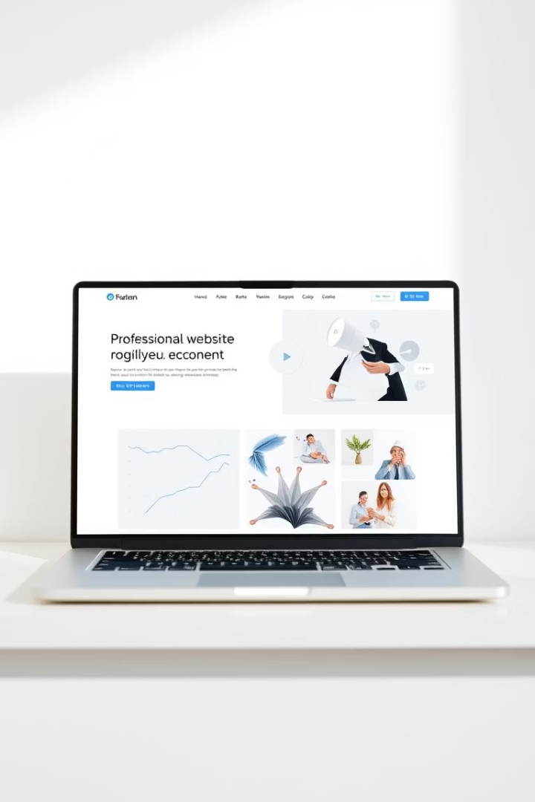
Project Scope and Objectives
Scope
Objective
End-to-end design and implementation of a user-friendly, visually consistent website to amplify The Knots Studio’s reach and streamline client communication.
Create a professional platform that communicates the brand’s offerings, values, and story, serving as a lead generation and client interaction tool.
Out-of-Scope
Excludes full branding overhaul, payment integration, e-commerce features, and social media management.

Slide 4
In-Scope Deliverables
Planning & Strategy
Design & Development
Platform Setup & Handoff
Requirements gathering with sponsor
Mobile-responsive, clean design
Build on Wix or WordPress CMS
Homepage with brand narrative
Documentation for content updates
User personas and journey mapping
Service pages, testimonials, gallery
Optional design assets if needed
Competitor benchmarking and SEO alignment
Contact form and basic SEO

Slide 5






Functional Requirements
Homepage
Engaging design with brand mission, hero imagery, CTAs, and navigation linking to all sections.
Service Pages
Dedicated pages for corporate gifting, weddings, seasonal offers with descriptions, images, and inquiry buttons.
Gallery & Testimonials
Visual portfolio arranged by event type and client testimonials to build trust.
Contact & Navigation
Easy contact form, embedded Google Maps, consistent header and footer with quick links and social icons.
D
By Deepthi Sri

Slide 6
Non-Functional Requirements
Responsiveness
Performance
Accessibility & Usability
Security & CMS
Website must work seamlessly across PCs, tablets, and smartphones.
Fast loading times under 3 seconds with optimized images and minimal scripts.
HTTPS for data security, CAPTCHA on forms, and a user-friendly CMS for easy content updates.
Adherence to accessibility guidelines, clear navigation, legible fonts, and intuitive user experience.

Slide 7
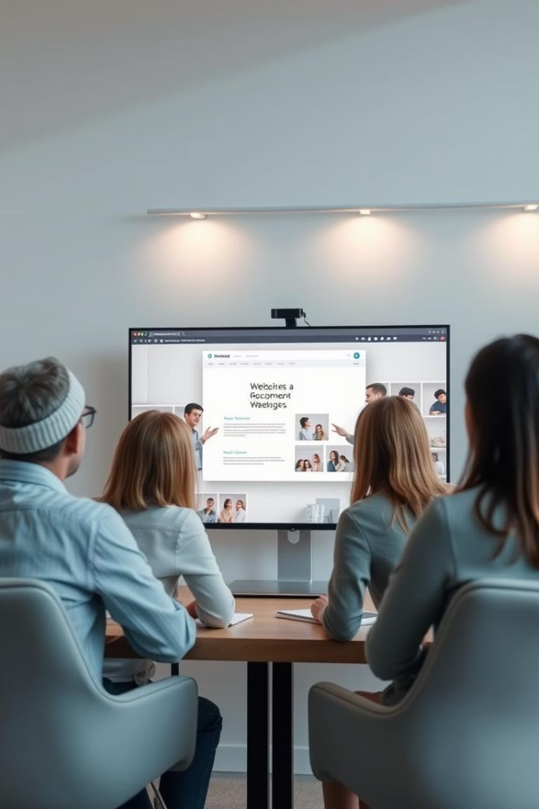
Project Management and Communication
1
Initial Requirements Gathering
April 5, 2025, Zoom meeting to discuss goals, scope, and creative direction.
2
Midpoint Design Review
April 20, 2025, Zoom session to review homepage and service page layouts.
3
Final Prototype Review
May 3, 2025, Zoom meeting for design sign-off and feature approval.
4
Handover & CMS Training
May 10, 2025, Zoom/Google Meet for website transfer and sponsor training.

Slide 8

Success Criteria and Impact
Success Criteria
Impact
On-time delivery, functional and brand-aligned website, sponsor satisfaction, live and accessible platform.
Establishes The Knots Studio as a credible gifting brand online, expands reach, supports lead capture, and enhances storytelling.
Value
Sets foundation for future marketing and digital scaling, empowering the sponsor to maintain and update the site independently.

Slide 9
Sponsor and Contact Details
Sponsor
Location
Ms. Aarthy Balachandran, Founder & Creative Director, The Knots Studio
No.343, Daiwik Gokul, 14th cross, 2nd block, Jayanagar, Bangalore 560011
Email: Theknotsstudio@gmail.com
Phone: +9980230859

Slide 10
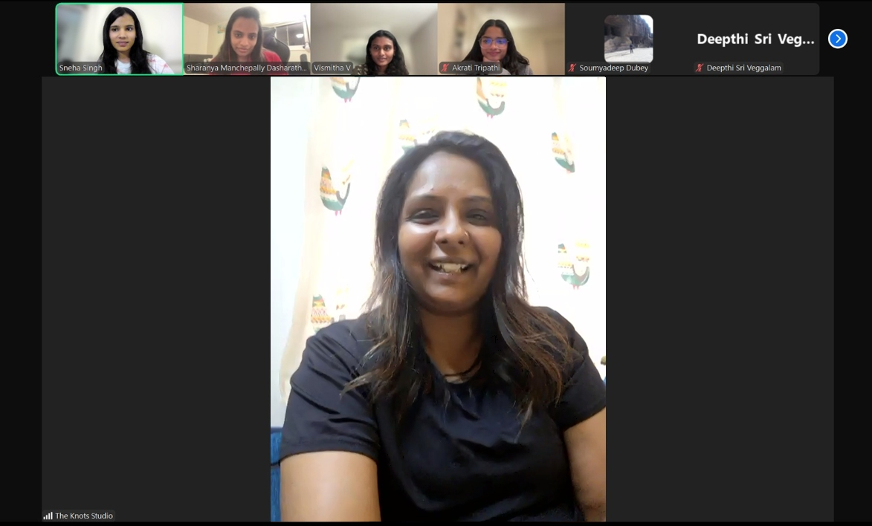
Evidence of the Meeting with the Sponsor
Team meeting with Ms. Aarthy Balachandran, Founder & Creative Director, The Knots Studio

